Slide 1
Keyboard Finger Position Display
Techblazers

Slide 2
Introduction of Hardware (Arduino Nano and MPR121 Capacitive Touch Sensors)
How the Arduino Nano and MPR121 Capacitive Touch Sensors are powered
Arduino Nano is powered via Mini-B USB connection
MPR121 Capacitive Touch Sensor takes input power from the Arduino
How the Arduino Nano and 2 Capacitive Touch Sensors are wired together and integrated with the keyboard
28 AWG wire of one end is inserted into the breadboard next to one of the 12 channels of both MPR121 Capacitive Touch Sensors
The other end of the wire is connected to aluminum tape that is on top of a key which serves as the conductive material that can increase the capacitance area of detection as the electrode
The aluminum foil serves almost as one plate of a capacitor while a person’s finger serves as the other plate
How the MPR121 Capacitive Touch Sensors are able to handle the amount of input voltage from the Nano
Voltage regulator installed on the MPR121 Capacitive Touch Sensor chip board by the manufacturer that can convert 3-5V DC Voltage down
Victor Siooh

Slide 3
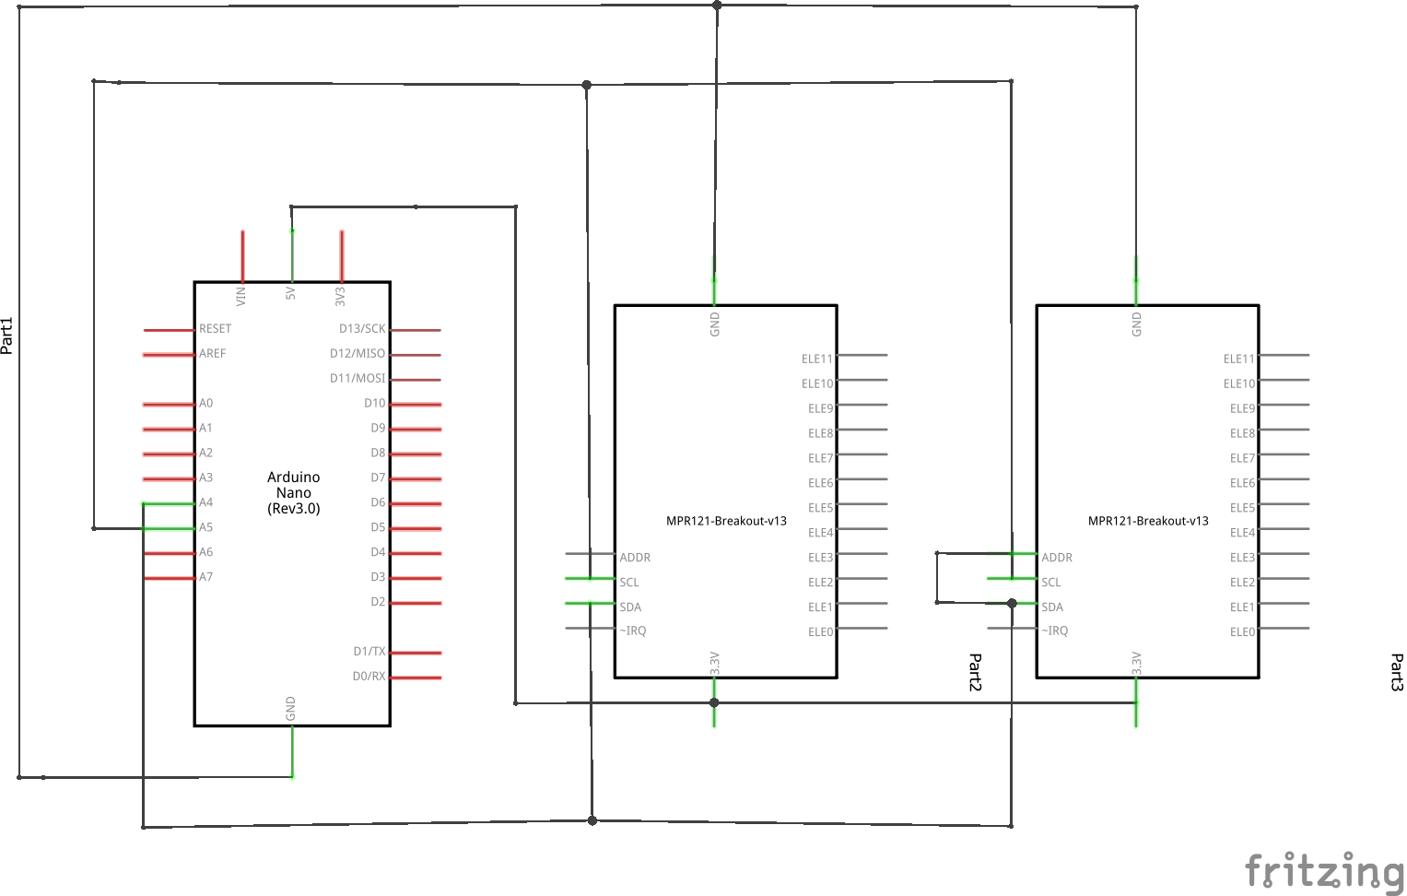
Victor Siooh

Slide 4
Arduino Nano and MPR121 Capacitive Touch Sensor Breakout Board Communication
How the Arduino Nano and Capacitive Touch Sensors are communicating
Both use an I2C serial communication protocol (Two Wire, SDA & SCL)
SDA (Serial Data) – The line for the master(Nano) and slave (Capacitive Touch Sensors) to send and receive data
SCL (Serial Clock) – The line that carries the clock signal.
Optional IRQ interrupt pin to advise of electrode input. The use of this pin will decrease delay.
I2C has a default clock speed of 100 kHz and can be pushed to 400 kHz with the Arduino Nano with its microcontroller clock speed being the limiting factor.
MPR121 has a 16ms sampling interval. This needs to be combined with any latency in the I2C connection when calculating total latency. Result will be dependent on clock speed as well as the use of the IRQ pin.O
How to connect multiple slave I2C devices to the same SDA and SCL lines
Multiple slave devices on a single I2C bus requires the devices to have unique addresses for the master to differentiate signals.
The MPR121 hardware has a selectable address feature which is used by connecting the ADDR pin to one of four lines on the device, (VSS, VDD, SDA or SCL) which results in the addresses 0x5A, 0x5B, 0x5C and 0x5D respectively.
Connecting more than four to one Arduino
The final iteration of the product will require more than four MPR121’s.
This is possible using a multiplexer and will be explored more thoroughly next semester.
Slate Jordan

Slide 5
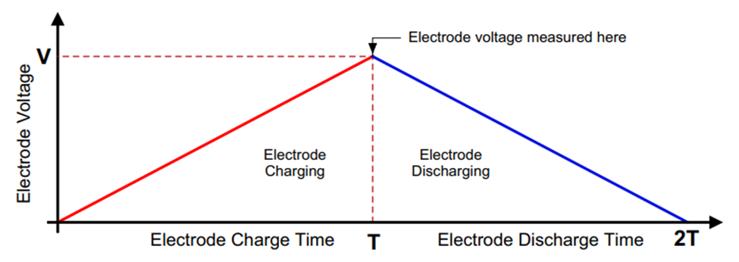

How a Touch is Detected
How the device measures capacitance
Capacitance range it can detect: 10-2000 pF
Each electrode voltage is charged and discharged with a capacitor
Sensor measures voltage at peak and converts this to an ADC count value
10-bit analog to digital converter
You need a formula to find the capacitance based on the ADC counts
How to calculate the capacitance
I is the charge discharge current
T is the charge discharge time
1024 is the ADC resolutions
1024 = 2^(10)
10 comes from the 10-bit ADC
Chase Williams

Slide 6
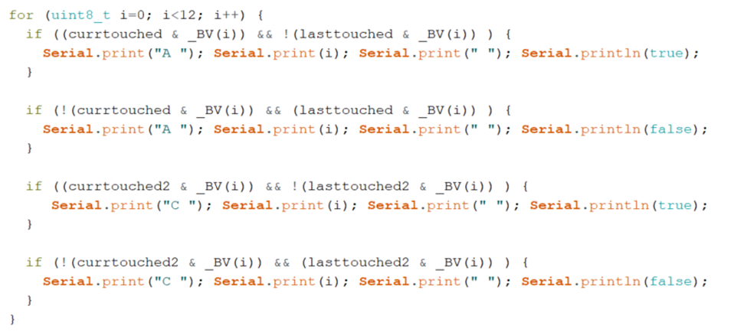
How a Touch is Detected Cont.
Arduino Code
Records the change in ADC counts from one time to another
A threshold determines if a touch or release occurred
Touch definition: ADC counts difference increases to 12 counts and above
Release definition: ADC counts difference decreases to 6 counts and below
A touch is typically less than 1pF of additional capacitance
Decision to use open source libraries
Speed is the big factor
Modified code will be helpful for creating proximity sensors in the future
Data sent through the serial port to be read by the app
Information about which keys are touched or released
Text string format: “A 6 0”
The letter is the last character of the address of the capacitive touch sensor
The first digit is the pin number on the sensor
The last digit tells whether the key was touched or released
0 = released
1 = touched
Chase Williams

Slide 7
Arduino IDE Code Integration Into Visual Studio (Chief)
Reasons for the choice of software environments used in project
Arduino IDE
Arduino kit was in possession by a member of the group, Did not need to purchase any alternatives.
Coding environment written in C/C++, language which is common in the group
Contains large libraries of code, including the specific library (MPR121) required for our project
Explaining how the data is transferred from the Arduino IDE to Visual Studio Code IDE
Use of Serial Port reading
Includes the need of the external library (PySerial): Which is imported into the Arduino IDE.
Baud Rate:How fast COM ports operate.
Port: Name of the port that is used(Obtained within Device Manager)
Parity Bits: Used for error correction
Stop bits - Only used if there are timing issues
Time out - To prevent serial port from hanging
Chief Boateng

Slide 8
Arduino IDE Code Integration into Visual Studio(Cont’d)
General Explanation of what Serial Ports do
Enable users to run their hardware data through the Arduino IDE(Receive data)
Also allows users to send data out to be used in other coding environments.
Steps Involved in serial Port Reading
Import used Libraries (Serial and Time)
Initialize serial Port with variable definition used in Serial library
Functions used:Within the Setup() Function we initialize the variable which needs to be read and printed (In the code used, this is ‘serialString’)
Readline():reading a string from a serial port
Print : to output the results of serial data.
Chief Boateng

Slide 9
Visual Studio Code
Uses tKinter widget module
Runs loops to create keys with specifically selected boundary thicknesses specifically placed to best mimic the layout of a physical keyboard.
Use equations to determine how far off to place keys
If statements for oddly sized ones
Layout is programmed to always overlay the window in use with partial transparency
Constantly looping every millisecond to check if anything needs to be updated
After() in tkinter
Keeps each key in an array sorted based on the keys’ positions on the keyboard.
When editing settings, can easily go through all keys and adjust each of them individually.
Emmitt Brandt

Slide 10
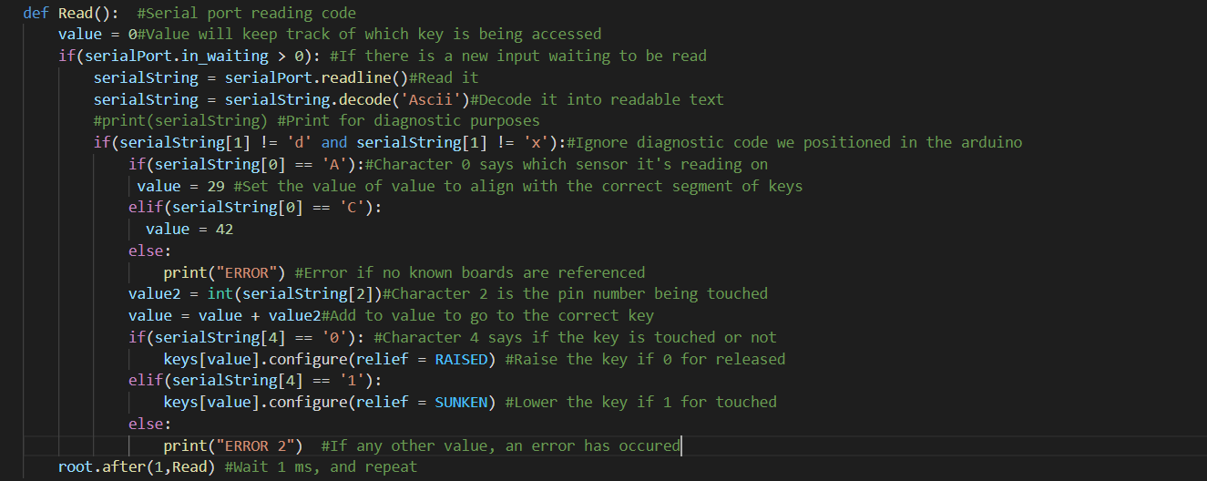
Visual studio Code Continued
Decode the input from the serial port to find the correct key, and adjust it’s layout appropriately
Emmitt Brandt

